Slide 1
Port City International University
Department of Computer Science and Engineering
Mid Terms
Course Title : Web Technology Lab
Course Code : CSE 434
Submitted to :
Zarin Rafah Chowdhury
Lecturer,
Department of Computer Science and Engineering
Port City International University
Submitted by :
Supri Devi
Program : B.Sc. in CSE
Batch No : 30th E-A
ID No. : CSE 030 07864
ology Lab Project

Slide 2
Hospital Management System Algorithm
Step 1: Start
Step 2: User opens the Hospital Management System.
Step 3: User logs in (Patient / Doctor / reception/Admin).
Step 4: Verify login credentials.
If invalid → Display error message and return to Login.
If valid → Open the dashboard.
Step 5: User selects a service.
Book Appointment
View Medical Records
Manage Patients
Manage Doctors
Billing & Payment
Pharmacy
Laboratory Reports
Step 6: Process the selected request.
Step 7: Save or update the information in the database.
Step 8: Display confirmation message.
Step 9: User logs out.
Step 10: End.

Slide 3
Flowchart

Slide 4
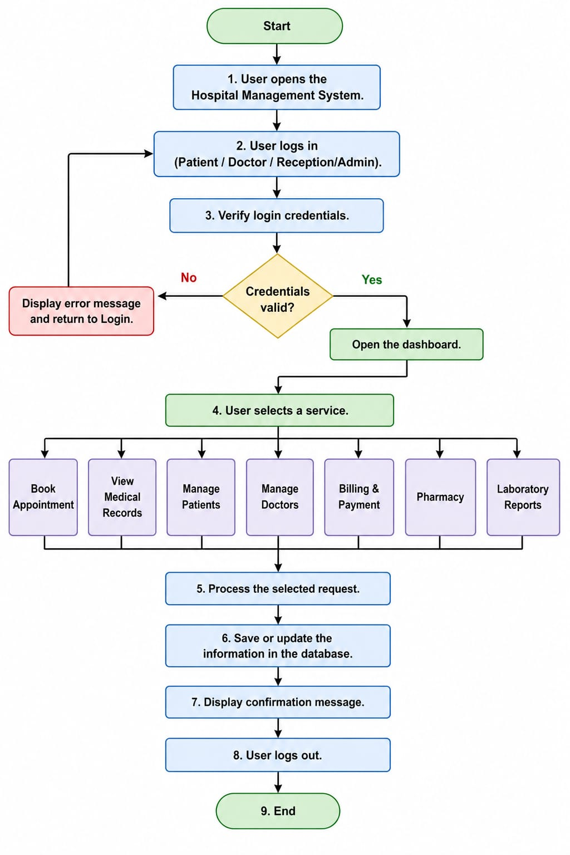

Slide 5
Thank You

